Slide 1

Power BI Intermediate Developer 6 week training 14th Jan - 18th Feb 2019 Trainer: David Moss E: david@wottabyte.com www.wottabyte.com

Slide 2






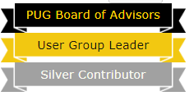

David Moss
Azure & Power BI Solutions
Delivering end to end architect & BI solutions both on-premises & Azure with a passion for Power BI visulisations across IoT, e-commerce & manufacturing verticals.
MVP Data Platform
2017 & 2018 awarded MVP for my community contributions. Co-leader of the London and Manchester Power BI User Group.
Power BI Global Advisory Board member.
@wottabyte
wottabyte
ACMA, CGMA Accountant
A qualified CGMA accountant all my career which keeps me commercially aware and able to work across the enterprise.
www.wottabyte.com

Slide 3
Power BI Intermediate Developer Lesson 1 of 6 Monday 14th Jan 2019
Agenda:
Introductions
Power BI Introduction & the PBI ecosystem.
Onboarding a .pbix each do a demo to understand level & ability. (PQE view, datamodel, datasource, trace base measures).
Power BI Drill-Through, Bookmarks, sync slicers & custom tooltips. (didn’t do so set as homework)
Homework: create a report with a slide on screen sync slicer (bookmark). (didn’t set as homework so will demo in Lesson 2.)
Setup wottabyte email, PBI workspace, Slack and an Azure subscription.

Slide 4
Power BI Intermediate Developer Lesson 1 of 6 Monday 14th Jan 2019
Agenda:
Better reporting techniques: arrows buttons
Better reporting techniques: Drill through
Better reporting techniques: Tooltip cards
Better reporting techniques: Bookmarks
Better reporting techniques: Sync Slicers (didn’t do)

Slide 5
Power BI Intermediate Developer Lesson 1 of 6 Monday 14th Jan 2019
Homework:
TASK 1: download the last file on the github called 'VanArsdel Performance.pbix’ (you too can recreate the file from scratch by following the instructions in the file DIAD.pdf on the same github and using the data.xlsx)
TASK 2: Drillthrough: on a new page in the .pbix report from Task 1 create a report with manufactuer's sales top level stats. tThen create a 2nd page with a more detailed Manufactuer's report and configure drill through from the 1st page to the 2nd page.
TAsk 3: Custom tooltip: add a 3rd page and create a custom tooltip such that the tooltip appears when you hover over a chart on 2nd page
Task 4: Create a 4th page report at your discretion and bookmark it then put an arrow on page 1 with a link to the bookmark page.
TASK 5 (optional) : learn about sync slicers
Links: https://github.com/wottabyte/PBITraining

Slide 6
Power BI Intermediate Developer Lesson 2 of 6 Monday 21st Jan 2019
Agenda:
Confirm all got an email account. (new link)
Go through and demo homework of drillthrough, arrows 2 bookmarks, custom tooltips
create a report with a slide on screen sync slicer (bookmark).
Power BI Streaming demos (without Oxford Uni Azure Streaming).
DAX datamodelling with multi tables, hierarchies and SCDs (type2).

Slide 7
Drillthrough, Custom Tooltips, Arrows Sliding slicers
Use L6-reportingTips.pbix
Drillthrough
Bookmarks
Arrows
Custom tooltips
Sliding slicer configuration
Notes:
C:\Users\david\Documents\CurAct2017\BIC\RoomCrowd\SmarterKey\Wottabyte\PowerBI Courses\2019\PBIIntermediate-Q12019\WIP-DemoFiles
L6-reportingTips

Slide 8
Power BI Intermediate Developer Lesson 2 of 6 Monday 14th Jan 2019
Hierarchies : path(child,parent), pathitem, pathdepth. Build a/cs hierarchy
Staging tables distinct join with 2 similar fact tables.
Many 2 many relationships: filter bi directional, now possible.
Multi Tables :
SCD type 2 : DAX code (homework ?)
Notes:
See Dublin Finance presentation
C:\Users\david\Documents\CurAct2017\2017_Study\PowerBI\Presentations\18_04 Dublin\Dublin_FinalPresentations\Accountant

Slide 9
Dax create hierarchy
Slides 15-20
DataBI Summit Power BI for Accountants
HierarchyPath = Path(child, parent)
PathItem1 = Pathitem(HiearchyPath,1)
Hierarchy Depth = Pathlength of (hiearchyPath)
Level1 = LOOKUPVALUE (account, where account,(=)pathitem,depth)
Level6 = if Hdepth>=6, Level6Lookup (else), ColumnLevel5)
Notes:
C:\Users\david\Documents\CurAct2017\2017_Study\PowerBI\Presentations\18_04 Dublin\Dublin_FinalPresentations\Accountant

Slide 10
Dax SCD2 homework
Hierarchy with a time stamp on dimSCD2
Basic using lookup from Fact table date driven…..alternative
With a dimDate as selector of the SCD2 period rather than Fact driven
SCD2 = CALCULATE( [BaseMeasureSales],
FILTER(‘dimSCD2',
MIN(‘dimdateSCD2'[MonthEnd]) >= ‘dimSCD2'[Start Date] &&
MIN(‘dimdateSCD2'[MonthEnd]) <= ‘dimSCD2'[End Date]
))

Slide 11
Power BI Intermediate Developer Lesson 2 of 6 Monday 21st Jan 2019 Extras and homework
Extras:
Workspaces good practice with both old & new workspaces. (see 1.1a)
Power BI financial data modelling & Time Intelligence. (link to sqlbi.com handout. Check they all have done lesson 2 of EdX.org course)
Research Power Query Editor, parameters.
Setup wottabyte PBI workspace and each subscribe for an Azure subscription.
Subscribe to YouTube channels: Guy in a Cube, Microsoft channel.

Slide 12
Power BI Intermediate Developer Lesson 3 of 6 Monday 28th Jan 2019
Agenda:
Confirm all uploaded content into WB PBI workspaces. & workspaces.
Go through and demo homework. LAb2 See slack channel #homework.
Power BI Streaming demos (without Oxford Uni Azure Streaming).
Power Query Editor & Parameters (dev/prod server).
DAX datamodelling with YTD & time stamped SCDs (type2).
Workspaces good practice and deploying Apps
Power BI Premium, incremental refresh.

Slide 13
DAX lesson 3 of 6 see Lab 2 homework
Check homework from week 2 on Time Intelligence.
Use demo file TPBIApprentice-EndLab3 from C:\DAT207x\Lab3
Total Sales: calculates the total sales.
LY Sales: calculates last year sales.
Sales Var: calculates sales variance between this year and last year sales.
Sales Var %: calculates sales variance between this year and last year sales in percentage.
YTD Sales: calculates YTD sales.
LY YTD Sales: calculates last year YTD sales.
YTD Sales Var: calculates sales variance between this year and last year YTD sales.
YTD Sales Var %: calculates sales variance between this year and last year YTD sales in percentage.
Total VanArsdel Sales: calculates sales for VanArsdel manufactured goods.
% Sales Market Share: calculates the percentage of VanArsdel manufactured goods from the total sales.

Slide 14
Dax helper but units not sales Lab 2 : Sales
If you're stuck, check out the following DAX expressions to calculate similar measures, but on Units instead of Revenue.
Total Units: Total Units = SUM(Sales[Units])
LY Total Units: LY Total Units = CALCULATE([Total Units],SAMEPERIODLASTYEAR('Date'[Date])
Total Units Var: Total Units Var = [Total Units] - [LY Total Units]
Total Units Var %: Total Units Var % = DIVIDE([Total Units Var],[LY Total Units])

Slide 15
Dax helper but units not sales Lab 2 : YTDs
if you're stuck, check out the following DAX expressions to calculate similar measures, but on Units instead of Revenue.
YTD Total Units: YTD Total Units = TOTALYTD([Total Units],'Date'[Date])
LY YTD Total Units: LY YTD Total Units = CALCULATE([YTD Total Units],SAMEPERIODLASTYEAR('Date'[Date]))
YTD Total Units Var: YTD Total Units Var = [YTD Total Units] - [LY YTD Total Units]
YTD Total Units Var %: YTD Total Units Var % = DIVIDE([YTD Total Units Var],[LY YTD Total Units])

Slide 16
Dax helper but units not sales Lab 2 : Market Share
If you're stuck, check out the following DAX expressions to calculate similar measures, but on Units instead of Revenue.
Total VanArsdel Units: Total VanArsdel Units = CALCULATE([Total Units],Manufacturers[Manufacturer]="VanArsdel")
% Units Market Share: % Units Market Share = IF([Total VanArsdel Units]=0,0,DIVIDE([Total VanArsdel Units],[Total Units],0))

Slide 17
Power BI DAX YTD
YTD = CALCULATE ( [Base Measure],
FILTER ( All ( DimDate ) ,
dimDate [Year] = max (dimDate [Year])
&& dimDate [ Date ] <= Max ( dimDate [Date ]) ) )
>= max(dimDate[yyyymm)-12
https://www.daxpatterns.com/time-patterns/
https://www.daxpatterns.com/cumulative-total/
Homework do beginners DAX series Sam McKay 18 videos time 2 hours.
https://www.youtube.com/watch?v=gNR5yNczQ-s&list=PL1myWUzvmmDGmLfty3BDluz8nzme1dZxg

Slide 18
Dax SCD type 2
Copy code here
SCD2 = CALCULATE( [Base Measure],
FILTER(‘DIM',
MIN('date SCD2'[MonthEnd]) >= 'DIM'[Start Date] &&
MIN('date SCD2'[MonthEnd]) <= 'DIM'[End Date]
))
/* this is with SCD2 filter on the actual dimension hierarchy table
https://blog.tallan.com/2017/02/16/analysis-services-tabular-displaying-history-and-slowly-changing-dimensions/
https://blog.gbrueckl.at/2012/02/handling-scd2-dimensions-and-facts-with-powerpivot/

Slide 19
Power BI Query Parameters
Check query parameter in Power Query
Example use for server / dev url configure
Change value in the Power Bi Service
Insert parameter in M code (think filter manufacturer)
Also What if parameters on canvas

Slide 20
Power BI Workspaces best Practice
Use quick slide demo 1.1a

Slide 21
Power BI Lesson 4 of 6
Conclude PBI Streaming ( Fiddler & PubNub)
Review Homework with RANKX
PBI AAD B2B
Power BI Gateways
Scheduled Refresh
Row Level Security
Demos

Slide 22
Power BI Real time datasets: Streaming
See slides 15-27
DataBI-Summit - Streaming IoT Power BI Dashboards
Push to API from Fiddler
Pub Nub
Historic reporting
Azure Streaming Analytics demo (not time)…
Notes:
C:\Users\david\Documents\CurAct2017\2017_Study\PowerBI\Presentations\18_04 Dublin\Dublin_FinalPresentations\Streaming

Slide 23
Power BI Dax Homework
Ultimate Beginners 18 lessons 2 hours : Enterprise DNA training
1: Evaluation context (1.8)
2: Filter or Row depending on DAX
Filter context (1.9)
Row context (watch 1.10)
30 rolling days re Oliver question see 1.11
Video 1.18 DAX RANKX did you get it ? Next slide
Check this resource for DAX
https://www.powerpivotpro.com/wp-content/uploads/2015/10/PowerPivotPro-Reference-Card.pdf
Notes:
C:\Users\david\Documents\CurAct2017\2017_Study\PowerBI\Training\DNA Enterprise\UltimateBeginners18lesson2hour\Data-and-resource-downloads

Slide 24
Power BI DAX RANKX
Dynamic Top 10 dynamically by product.
Learn RANKX https://www.youtube.com/watch?v=HJdVfYkfhmE
Customer Group Profits =
CALCULATE( [Total Profits],
FILTER( VALUES( Customers[Customer Name] ),
COUNTROWS(
FILTER( 'Customer Groups’,
RANKX( ALL( Customers[Customer Name] ), [Total Profits],, DESC ) > 'Customer Groups'[Min]
&& RANKX( ALL( Customers[Customer Name] ), [Total Profits],, DESC ) <= 'Customer Groups'[Max] ) )
> 0 ) )

Slide 25
Power BI AAD B2B
Use slides from training 13.3

Slide 26
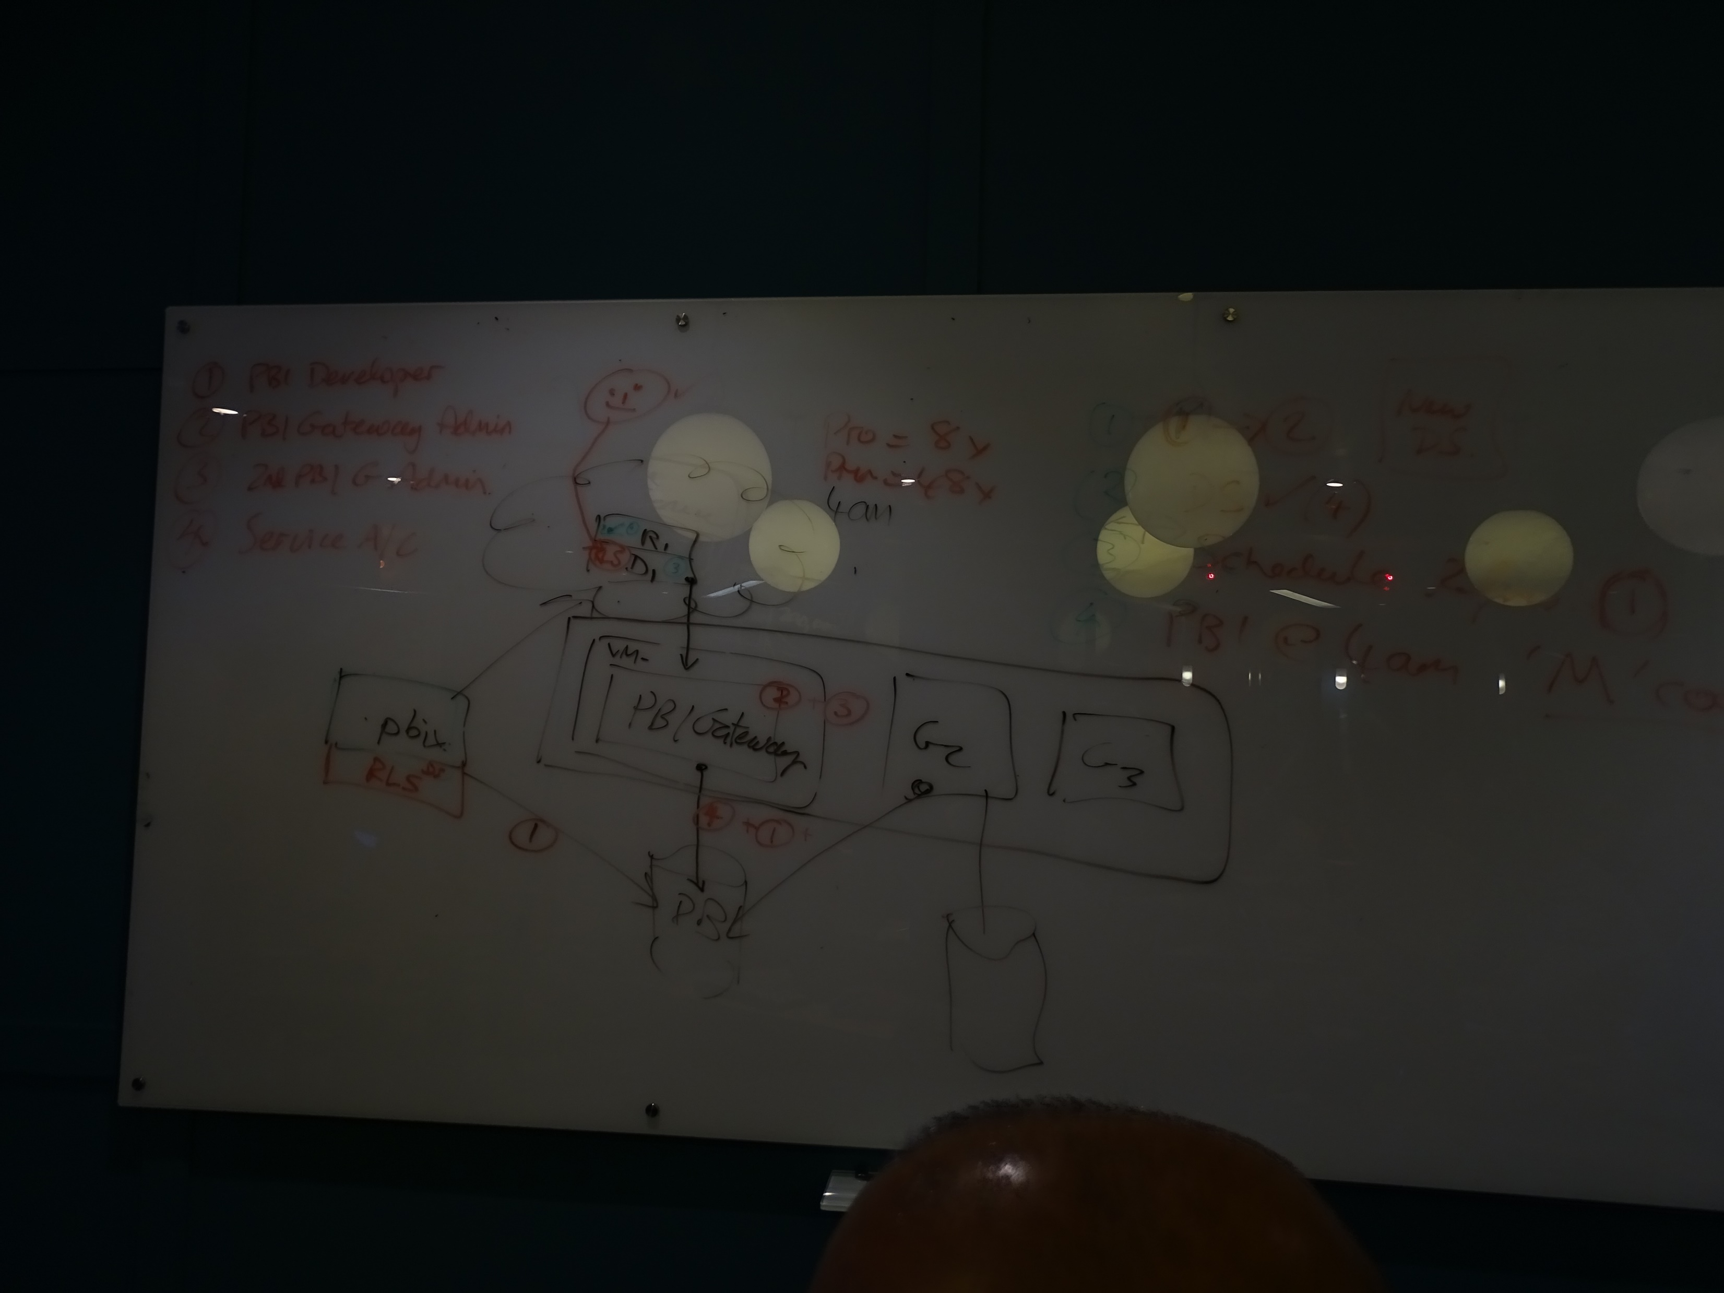
Power BI Gateways

Slide 27
Power BI Row Level Security
Homework do the Start Wars ship RLS many 2 many test.
https://datachant.com/2017/06/03/rls-star-wars-power-bi-challenge/

Slide 28
Power BI Int Email onboarding
Issue email account@wottabyte.com
Issue email onboarding instructions with webmail
http://192.185.116.148:2095
generic P@ssw0rd1

Slide 29
Power BI Lesson 5 of 6
Lesson 5 Mon 11th Feb 2019
PowerBI AI features @ Microsoft Reactor NOT at We Work
Register here:
https://www.meetup.com/Power-BI-Data-Scientist-Artificial-Intelligence-Solutions/events/258666451/
See slides on Cognitive Services

Slide 30
Power BI Lesson 6 of 6
Lesson 6 Mon 18th Feb 2019
Hoemwork Starwars RLS.
Final lesson : Demos of work progress in service. Any demos ?
Resume of what we have learnt. (review past slides)
Exam 70-778 enrol
Power BI grows up
Modelling 9 realms Turley (slides 19)
Direct Query . Try it our now.
Composite models : Direct query & cached.
Incremental refresh (also on Dataflows)
Power BI Premium explain what is.
Power BI Admin roles & duties
Enterprise rollouts (datamodellers/reporters/BAU consumers)
Other tools : DAX Studio/ Publisher for Excel/ PowerPoint Power BI Tiles /

Slide 31
Resume previous 5 lessons

Slide 32
Power BI Composite Data models

Slide 33
Direct Query
Do a demo of DQ
Do a demo of Live Connection (like to a PBI datamodel)

Slide 34
Modelling View
Preview Features: Enable modelling View
+add new datamodelling view
Drag a table on top the view
Right click the same table and add related tables.
In the properties pane you can Set common properties

Slide 35
Storage Mode
https://docs.microsoft.com/en-us/power-bi/desktop-storage-mode
Import / Direct Query / Dual
Dual think dimension in composite models
Even if DQ like a dimension now it is cached all the same for a composite datamodel to make it speedy.
Right click table > Properties>

Slide 36
Composite Datamodels
https://docs.microsoft.com/en-us/power-bi/desktop-composite-models
Multiple data connections DQ & cached.
If a relationship is cross-source then it must be many-to-many
See property pane to view table connection mode and settings

Slide 37
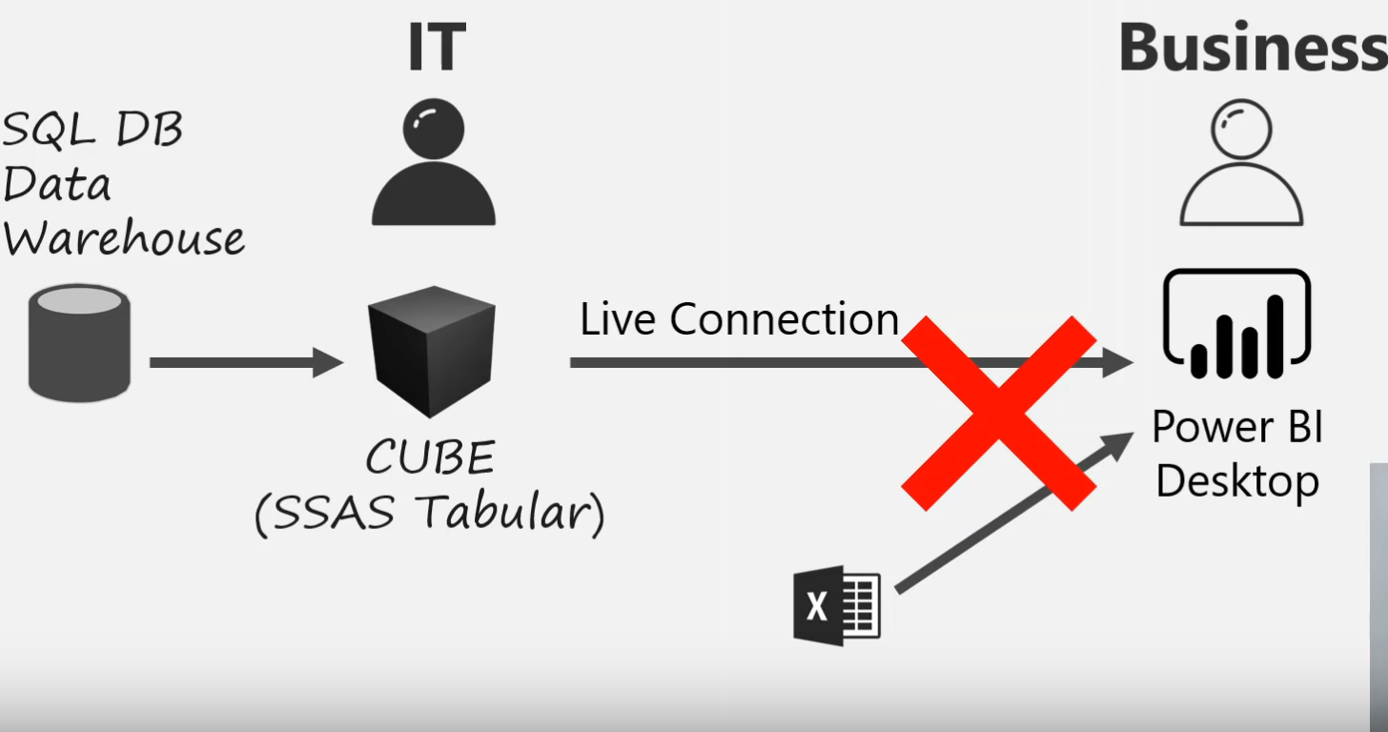
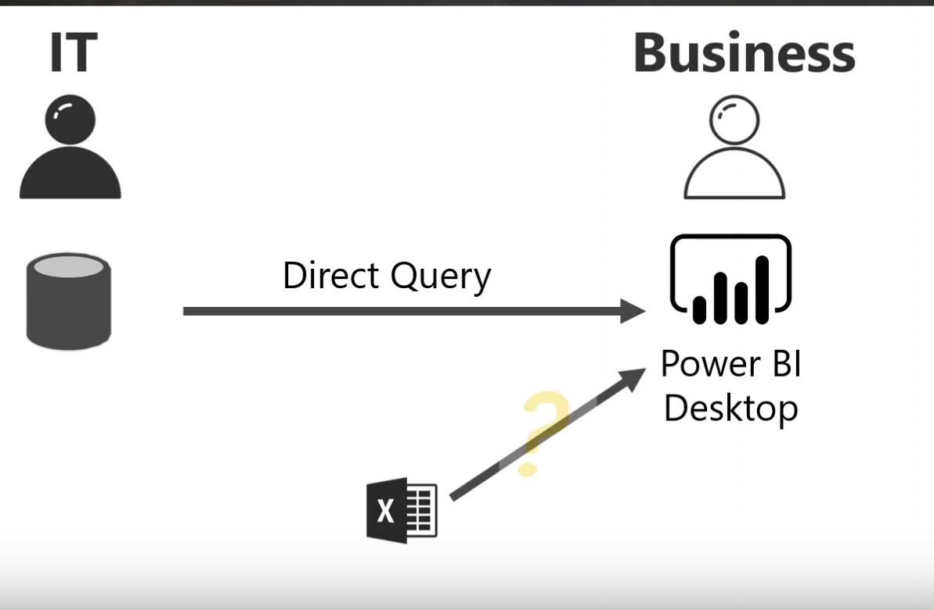
Power BI Composite Datamodels
Composite models Demo
Do direct Query (SQL DB) then model data see DQ only
Then do load data and see dual mode
Connect table and show many 2 many only
Then show table report (think sales v budget)

Slide 38
Many 2 Many relationships
From July 2018
https://docs.microsoft.com/en-us/power-bi/desktop-many-to-many-relationships
Historically 1 table must have unique attribute (think many to 1)
Avoids staging tables
Only mode for an aggregation table to hit the DQ source (see Aggregations)

Slide 39
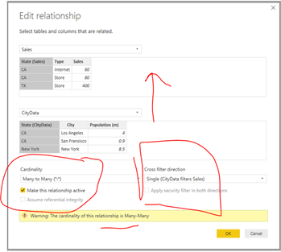

Slide 40
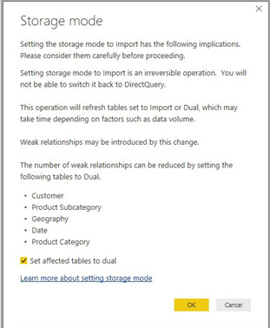
Aggregations

Slide 41
Aggregations
Agg tables with Chris Wade
https://www.youtube.com/watch?v=RdHSo43LkQg
Weak relationships v strong relationships
Hide aggregation table
Manage the actual aggregations, right click Agg table > Manage aggregations
Map agg table to detailed (DQ) table
Specify ‘Summaarization’ of the associated Detailed Table[column]
Summarizations Count/ GroupBY/ Max/ Min/ Sum/ CountRows
Talk about relationship models V Hadoop normalised tables and that GroupBy mapping for each column is required.
Different Aggregation tables and different granularity and Precedence.
https://docs.microsoft.com/en-us/power-bi/desktop-aggregations#aggregation-precedence

Slide 42
Power BI Tools
Sql Profiler
Dax Studio

Slide 43
Power BI Premium : Incremental Refresh
See https://www.youtube.com/watch?v=CajQjq70Kpg
Read https://docs.microsoft.com/en-gb/power-bi/service-premium-incremental-refresh
Preview feature
In Power Query set Parameters
Filter on date range is>= RangeStart and < RangeEnd
PBIdesktop data table define ‘incremental refresh’
Publish to Premium

Slide 44
Power BI Premium
See slides 5.2

Slide 45
Power BI Lesson 5 of 6
Lesson 5 Mon 11th Feb 2019
PowerBI AI features @ Microsoft Reactor NOT at We Work
Register here:
https://www.meetup.com/Power-BI-Data-Scientist-Artificial-Intelligence-Solutions/events/258666451/
See slides on Cognitive Services

Slide 46
Power BI AI
Microsoft is introducing four new AI-related features in Power BI:
Integration of Azure Cognitive Services
Integration of ML models hosted in Azure Machine Learning, including those built in Azure Databricks
The ability to create, and then use, ML models using Azure Automated ML (AutoML)
A new Key Driver Analysis visualization that reveals which columns and values drive specific outcomes (values) for data columns serving as measures or Key Performance Indicators (KPIs)

Slide 47
Power BI Dataflows

Slide 48
Power BI & R
See Oliver’s presentation

Slide 49
Power BI & Python
See Gaby’s presentation

Slide 50
Power BI Python
Create PBI visuals using Python
https://docs.microsoft.com/en-us/power-bi/desktop-python-visuals
Using Python in Query Editor
https://docs.microsoft.com/en-us/power-bi/desktop-python-in-query-editor
Use an External IDE
https://docs.microsoft.com/en-us/power-bi/desktop-python-ide
Run Python scripts in PBI
https://docs.microsoft.com/en-us/power-bi/desktop-python-scripts
Hands on demo files
https://powerbi.microsoft.com/en-us/blog/pythonblogepisode1/
See files here C:\Users\david\Documents\CurAct2017\2017_Study\PowerBI\Training\Python
Watch Justyna video on Python in Power BI
https://www.youtube.com/watch?v=G3Vxys_jsqY
Files here C:\Users\david\Documents\CurAct2017\2017_Study\PowerBI\Training\Python\JustynaHAwaiiDEmo

Slide 51
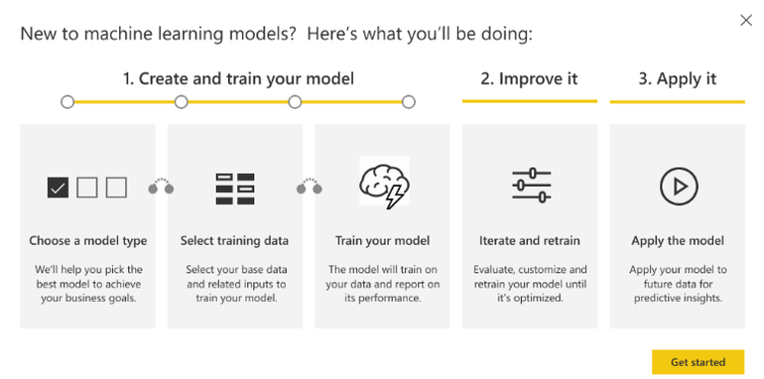
Power BI ML

Slide 52
Power BI Azure Machine Learning

Slide 53
Power BI Cognitive Services
https://azure.microsoft.com/en-us/services/cognitive-services/
As seen on Youtube video with Richard Tkachuk
https://www.youtube.com/watch?v=yrZ-nsOhSdA&t=2897s
Time 1:08:39
Create dataflow and from entities click brain and then configure the automated ML feature setting label, features and then model and see the report of % accuracy.
AI: Also with Will THompson
https://www.youtube.com/watch?v=uo_gaeN9zP0&t=38s
With Justyna (3 billion rows taxi ride & air condition picture sentiment).
https://www.youtube.com/watch?v=G3Vxys_jsqY

Slide 54
Spare slides if time
PBI Report Server slides and hands on demo. Fire up VM. £££

Slide 55
Power BI Report Server
SSRS
See slides 5.2 for enterprise PowerBI Report Server
All users on AAD added to have access. (missing a few)
Share RDP connector as added AAD group ‘PBIIntDev’ with all students to the PBIRS instance see IAM.
Notes:
See folder C:\Users\david\Documents\CurAct2017\2017_Study\PowerBI\Training\Power Bi Report Server\wbpbirs-AzureJan2019

